Slide 1
Types of Illustrations

Slide 2
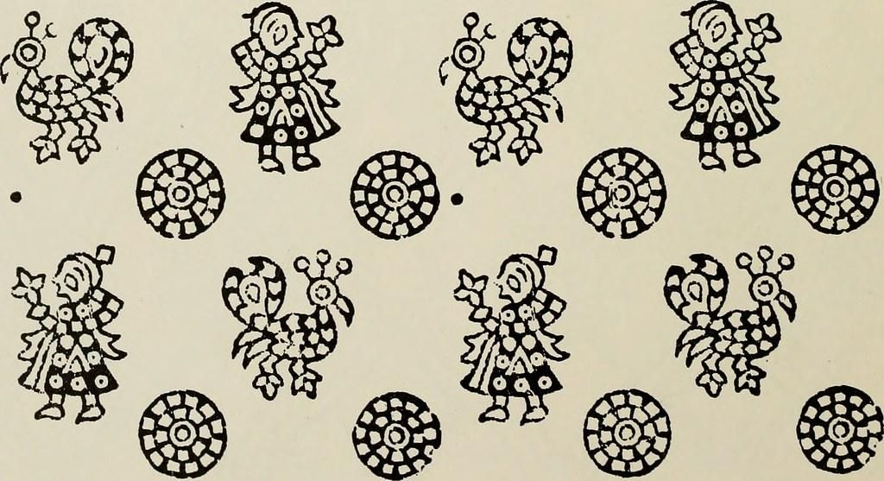
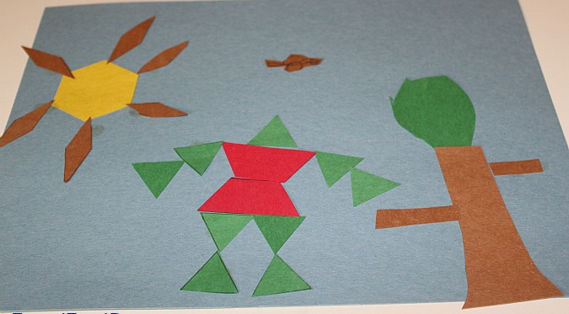
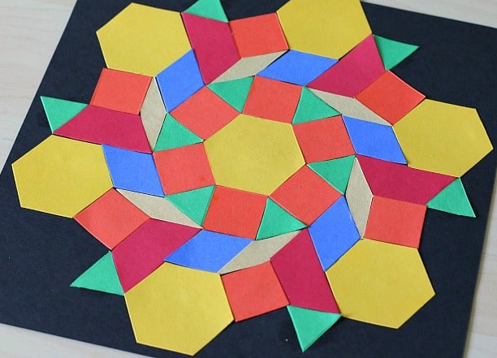
Block illustration
A block diagram is a visual representation of a system that uses simple, labeled blocks that represent single or multiple items, entities or concepts, connected by lines to show relationships between them.

Slide 3
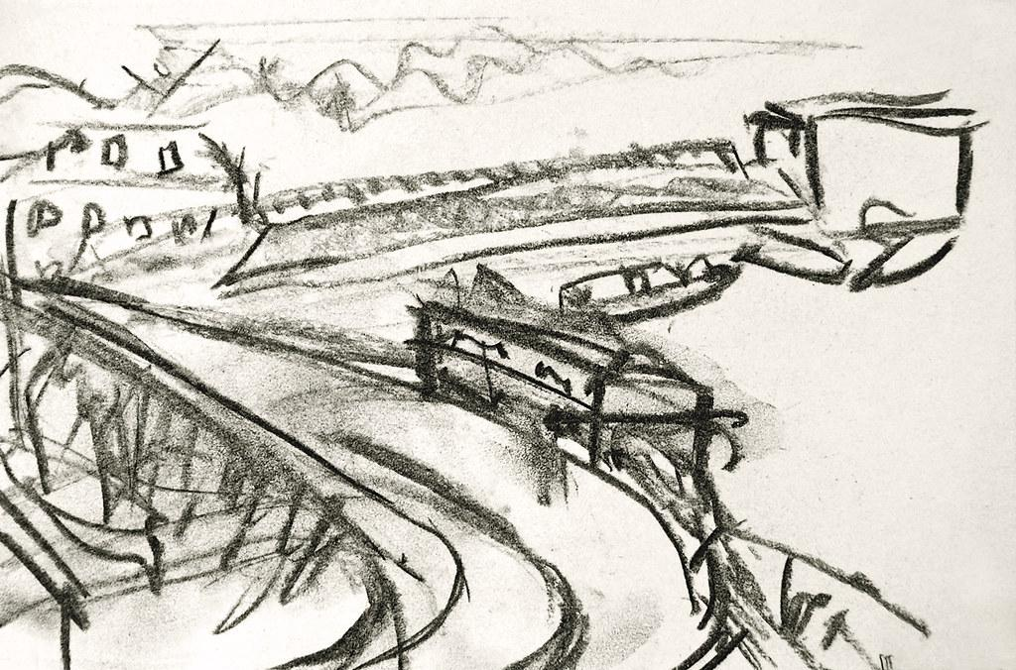
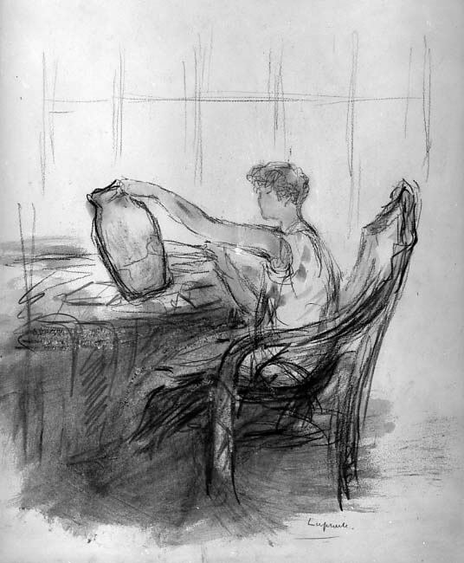
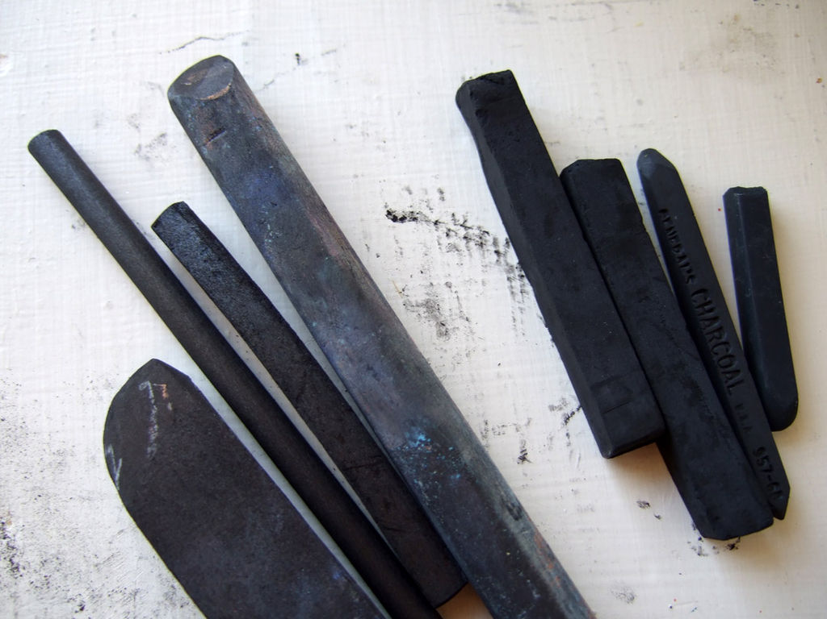
Charcoal illustration
Artists' charcoal is charcoal used as a dry art medium. Both compressed charcoal (held together by a gum or wax binder) and charcoal sticks (wooden sticks burned in a kiln without air) are used.
The marks it leaves behind on paper are much less permanent that with other media such as graphite, and so lines can easily be erased and blended.
Charcoal can produce lines that are very light or intensely black. The dry medium can be applied to almost any surface from smooth to very coarse.

Slide 4
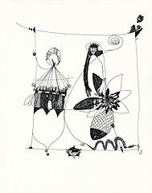
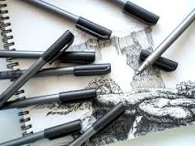
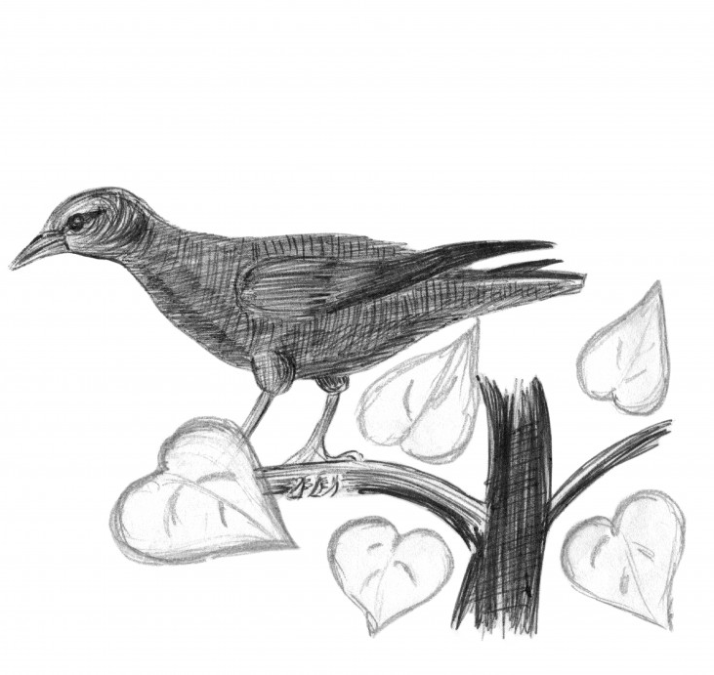
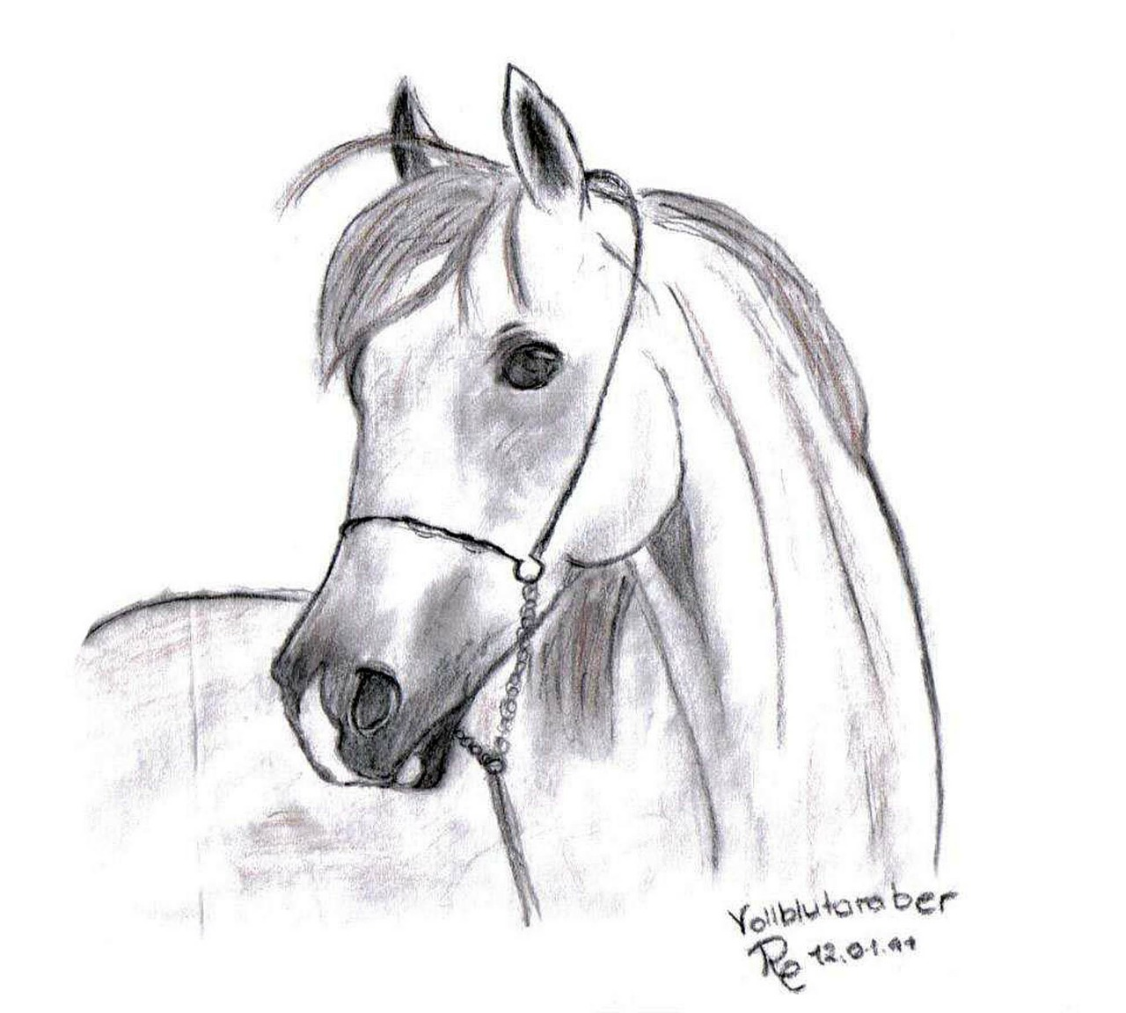
Ink illustration
What is ink art?
Pen and ink art is the process of using pens to apply ink to a surface. It has been popular with artists for many years, originating in ancient cultures.
Traditional black drawing ink, which originated in Asia

Slide 5
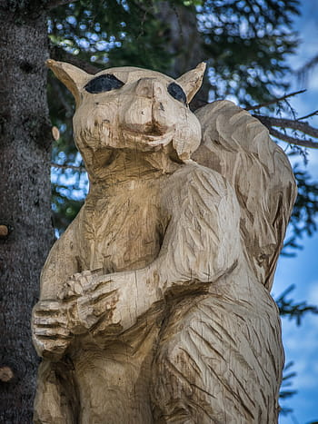
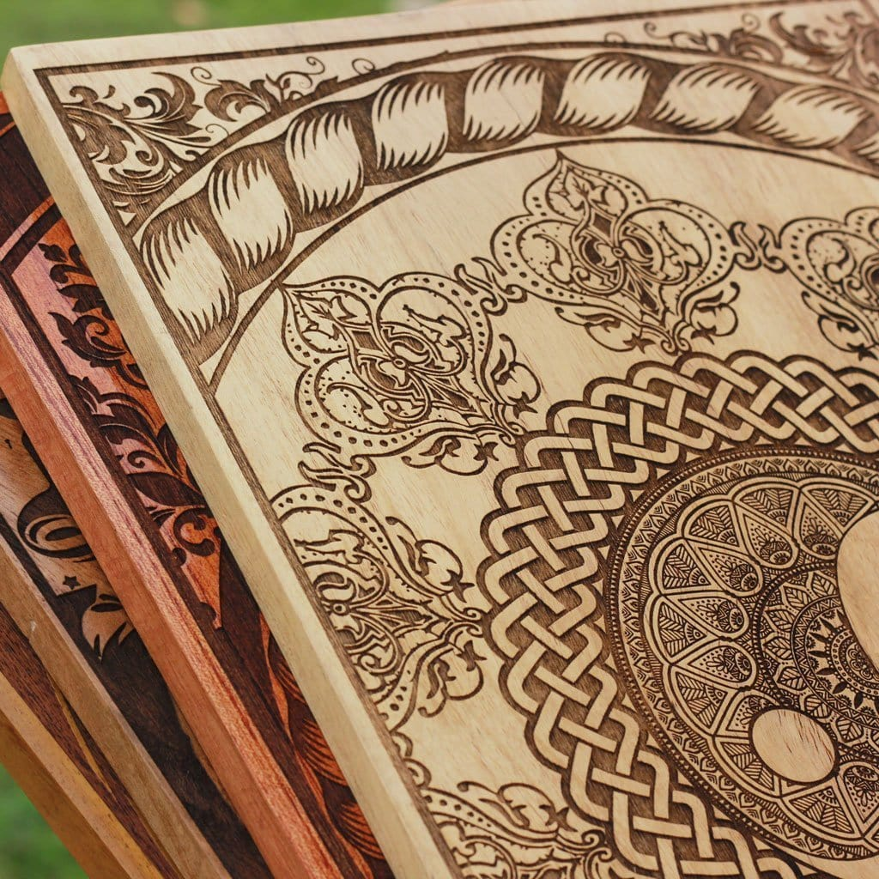
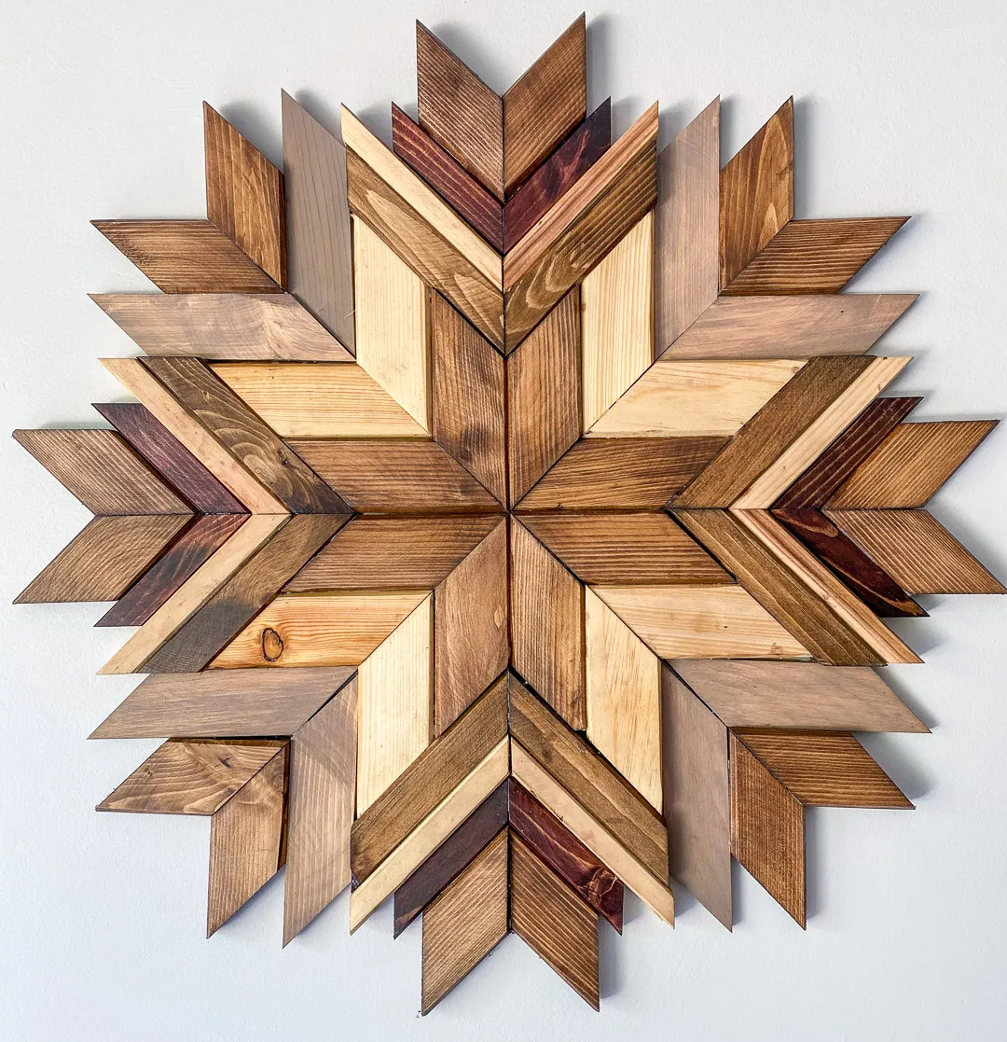
Woodcut Illustrations
Woodcut, technique of printing designs from planks of wood incised parallel to the vertical axis of the wood’s grain.
Art on wood - seen in all countries

Slide 6
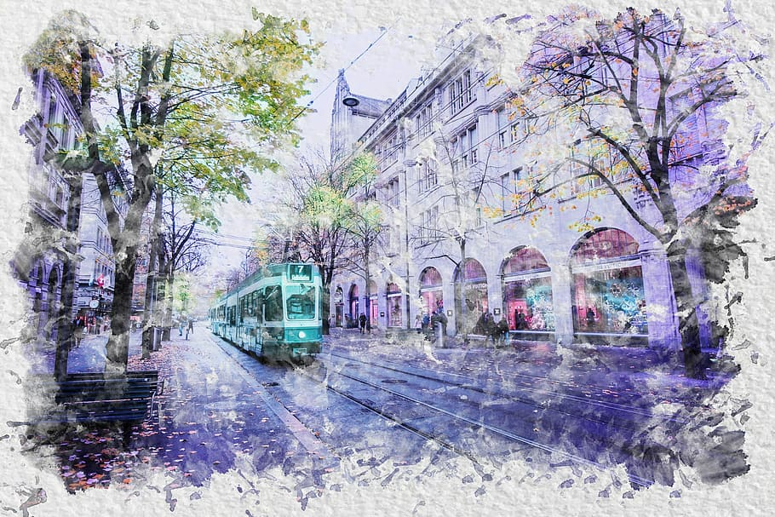
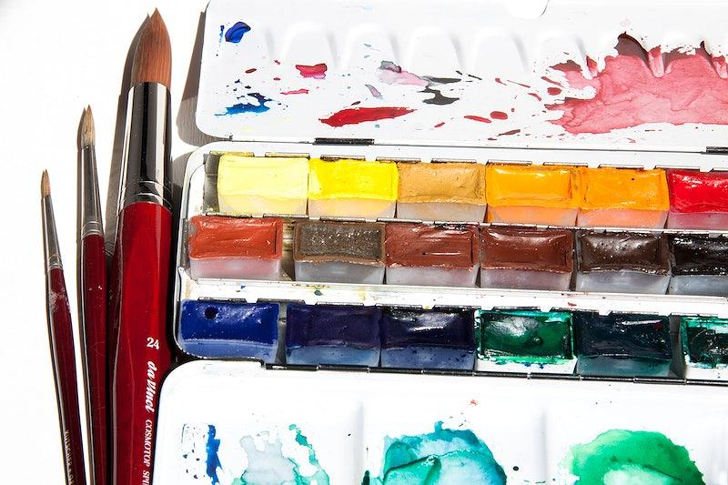
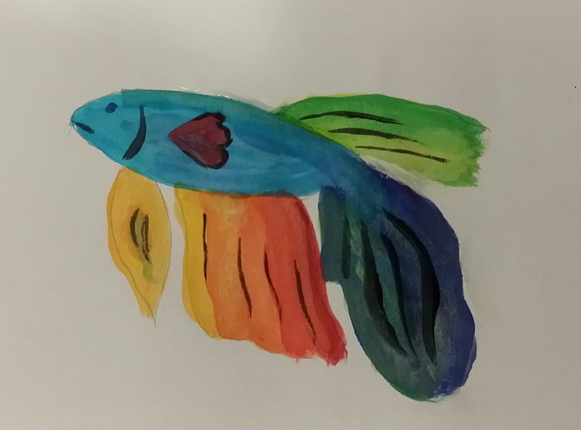
Watercolour illustration
Watercolor art refers to any works of art made using the medium of watercolor. Watercolor also refers to the medium, a water-soluble paint that has transparent or translucent properties.

Slide 7
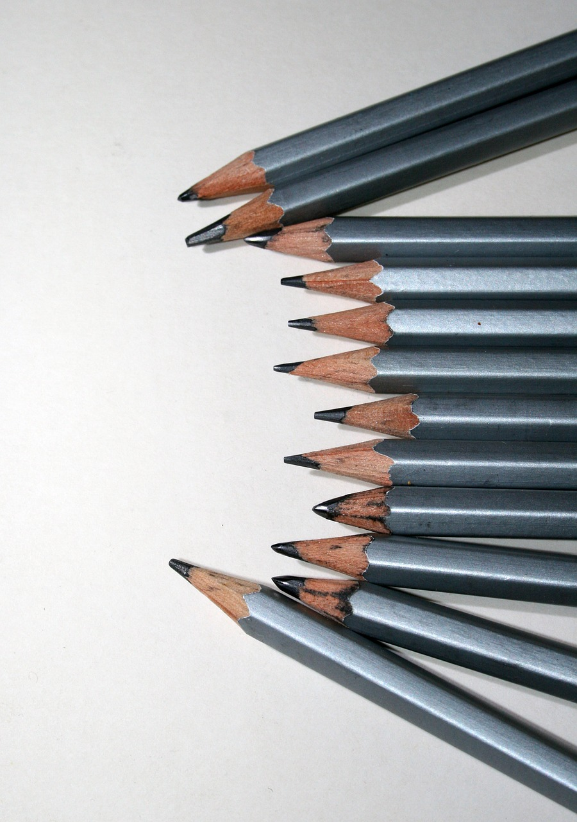
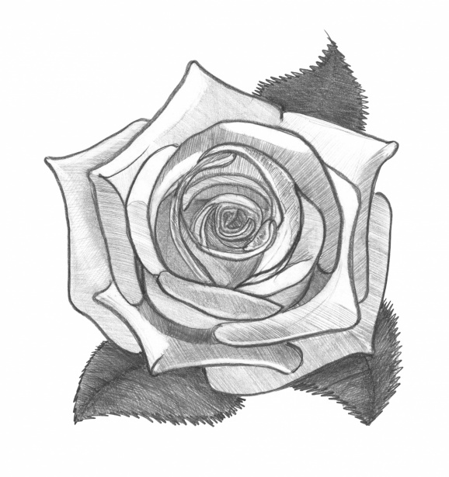
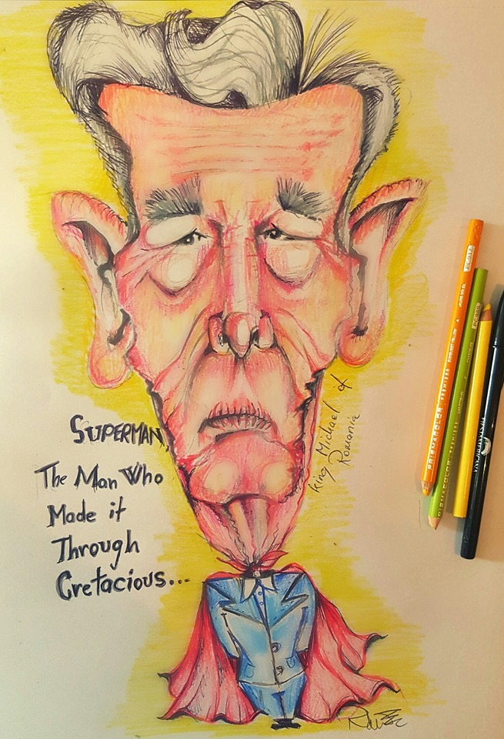
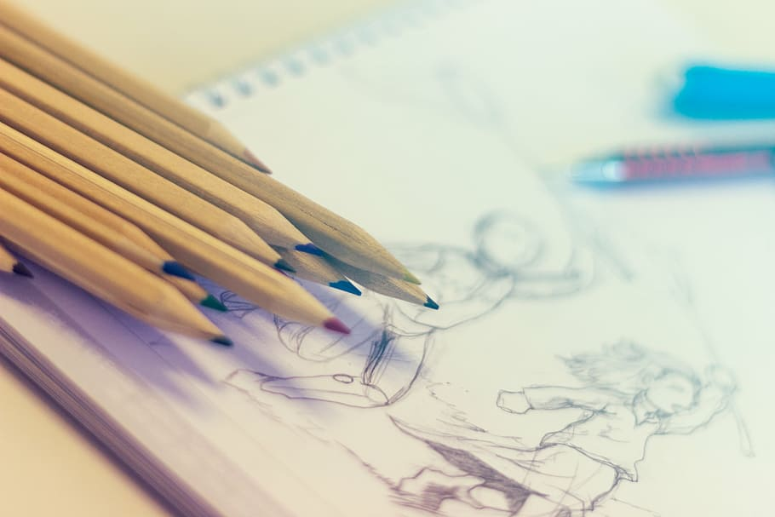
Pencil Illustration
Pencil illustrations is defined as using colour pencils or simple black graphite to create artwork.
Pencil illustrations are also called graphite art.

Slide 8
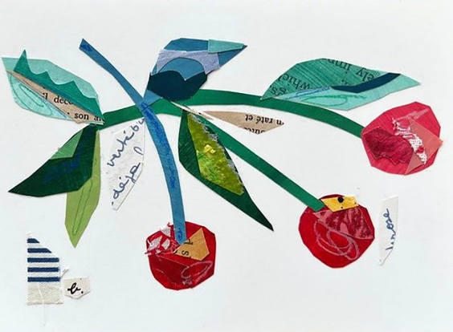

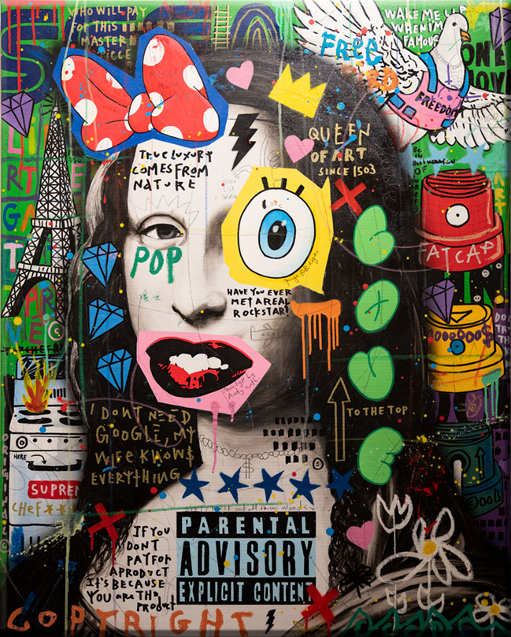
Collage Illustration
Collage is a technique of art creation, primarily used in the visual arts, but in music too, by which art results from an assemblage of different forms, thus creating a new whole. (Compare with pastiche, which is a "pasting" together.)
A collage may sometimes include magazine and newspaper clippings, ribbons, paint, bits of colored or handmade papers, portions of other artwork or texts, photographs and other found objects, glued to a piece of paper or canvas.

Slide 9
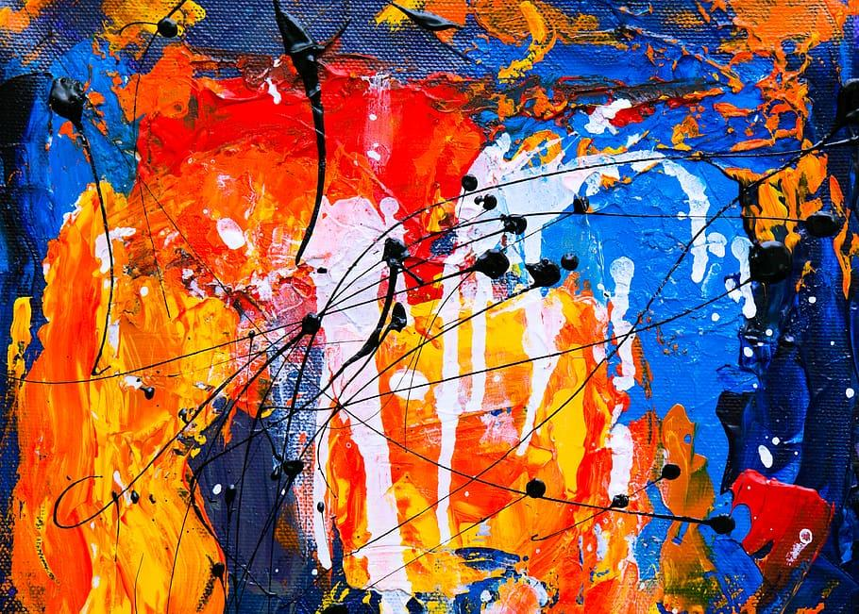
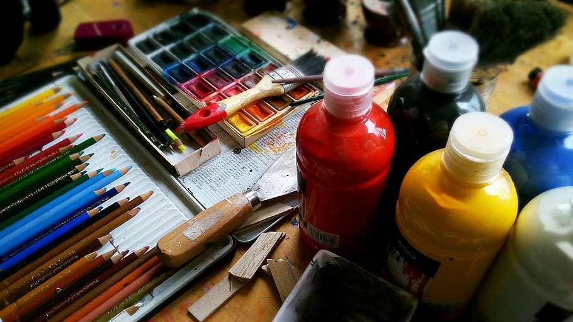
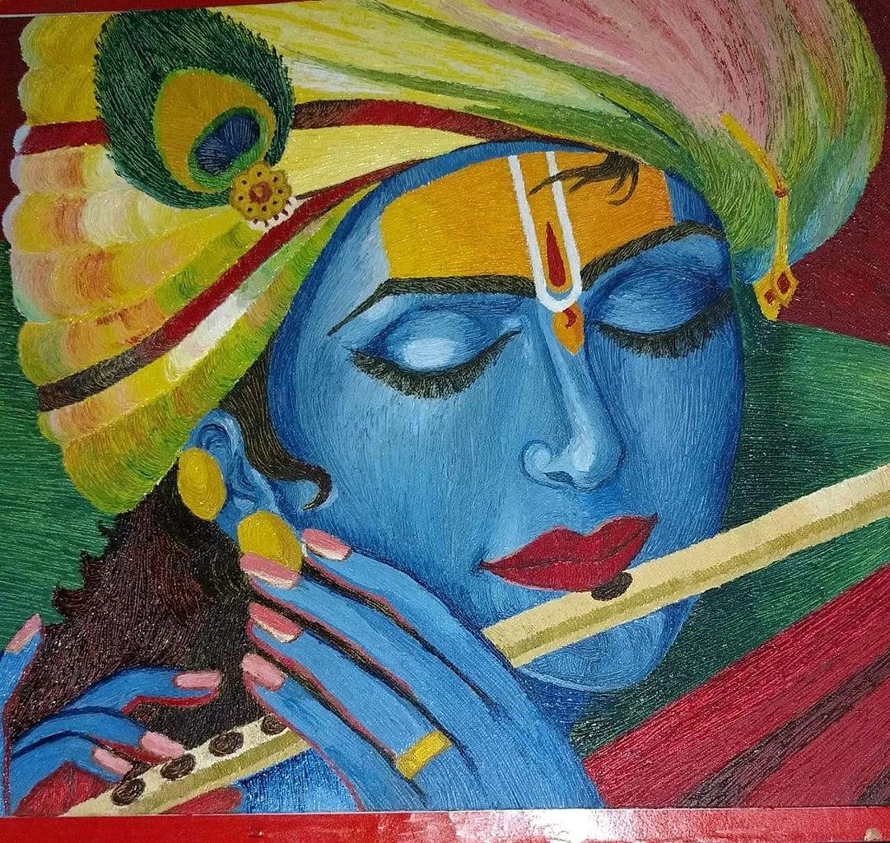
Acrylic Illustration
Acrylic art is a painting done with pigments in a solution of an acrylic resin: it dries quickly with a brilliance and depth comparable to those of both watercolor and oil paints.

Slide 10
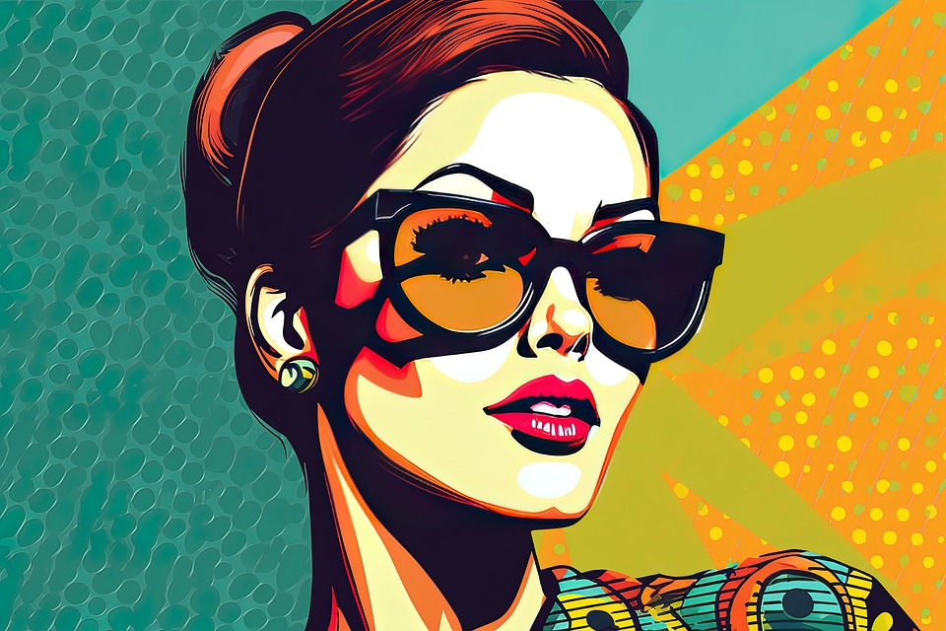
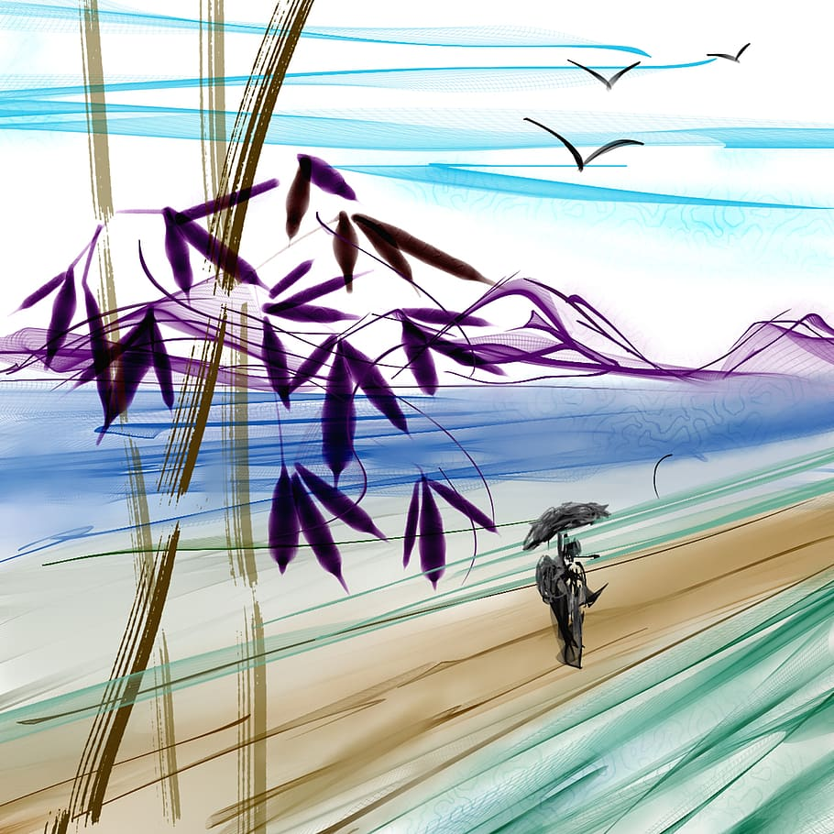
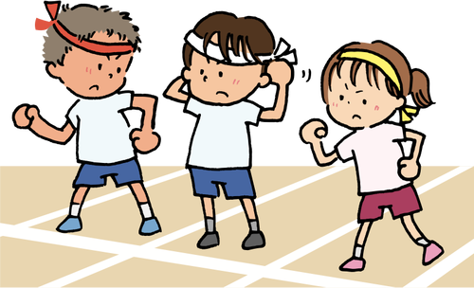
Digital Art
Digital art, once called computer art or new media art, refers to art made using software, computers, or other electronic devices. Anything produced or made on digital media, such as animations, photographs, illustrations, videos, digital paintings, and such can be classified as digital art.

Slide 11
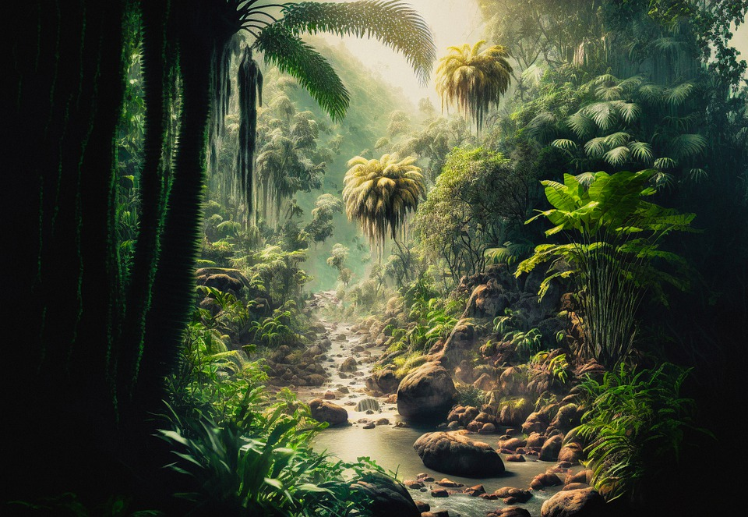
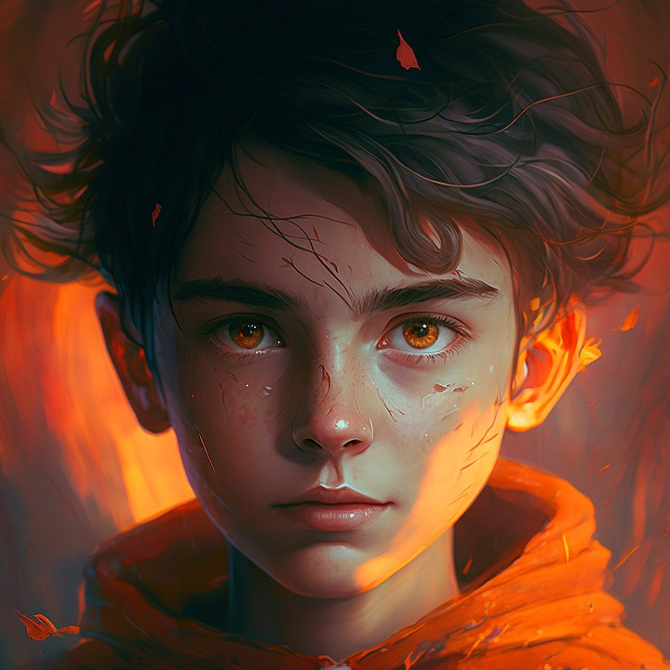
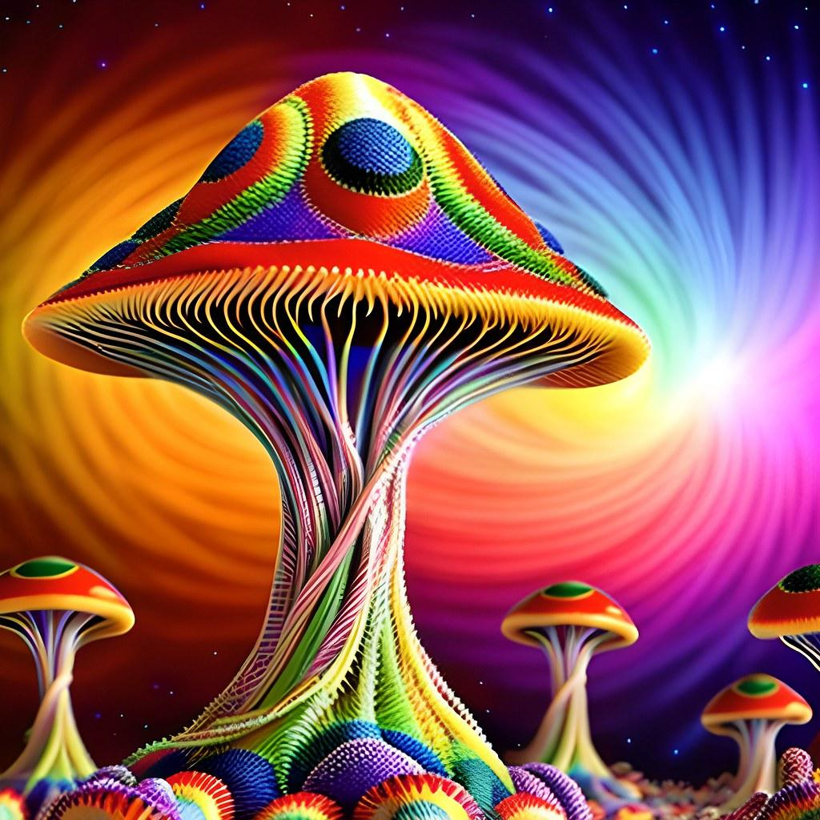
AI Art
Artificial intelligence art is any artwork, particularly images and musical compositions, created through the use of artificial intelligence (AI) programs, such as text-to-image models and musical generators.

Slide 12
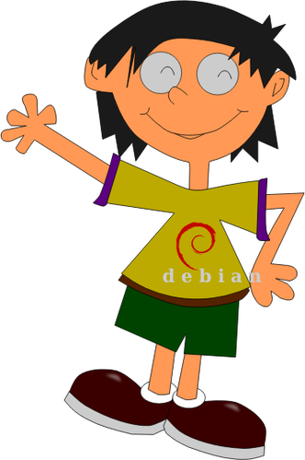
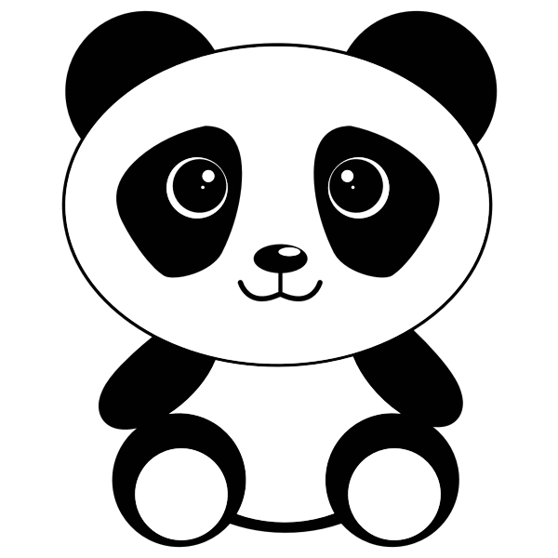
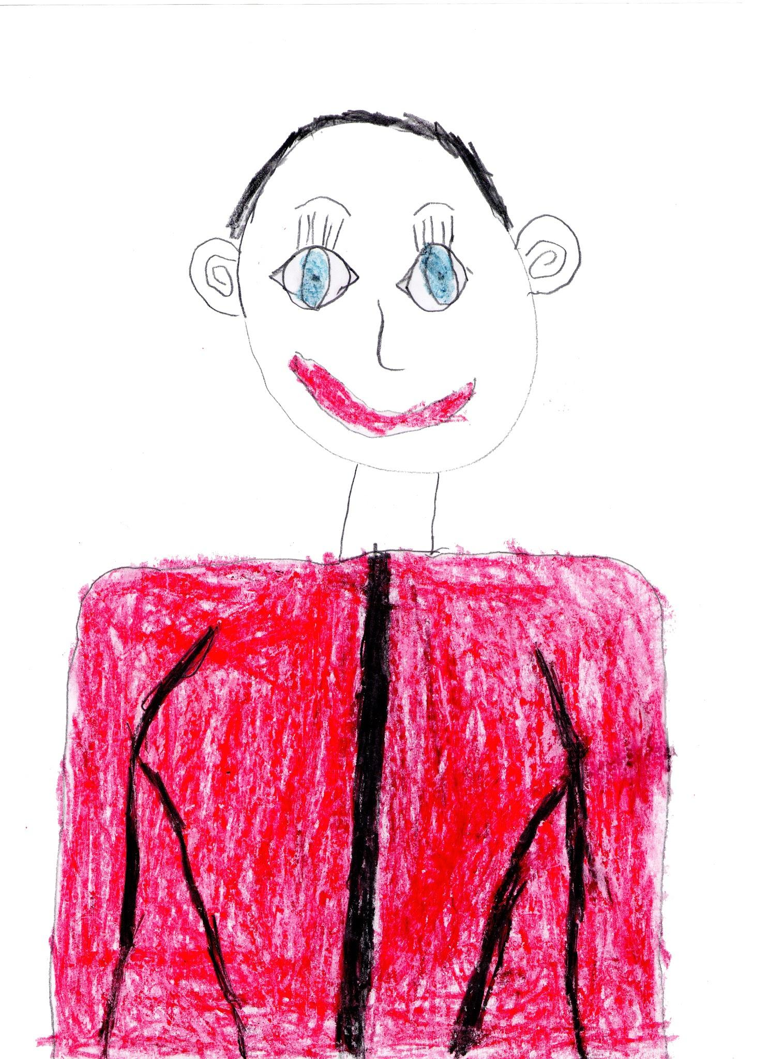
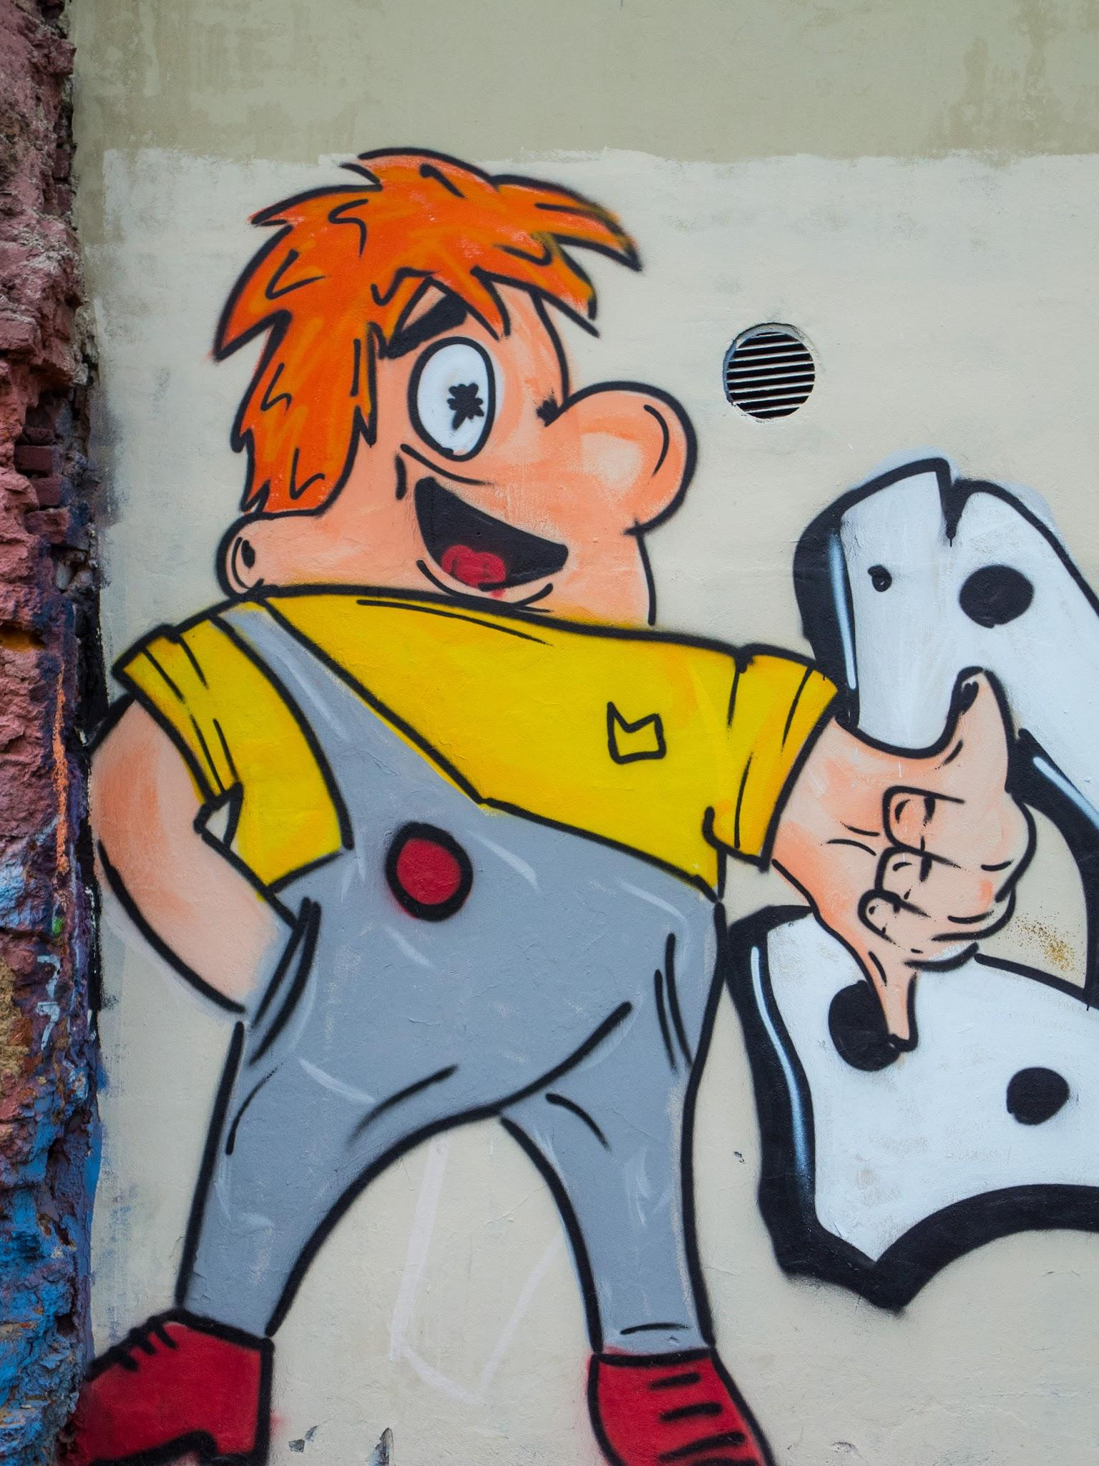
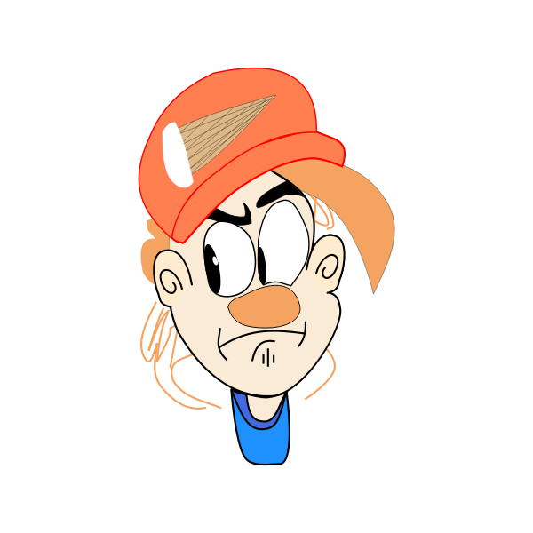
Cartoon
A cartoon is a type of visual art that is typically drawn, frequently animated, in an unrealistic or semi-realistic style.

Slide 13
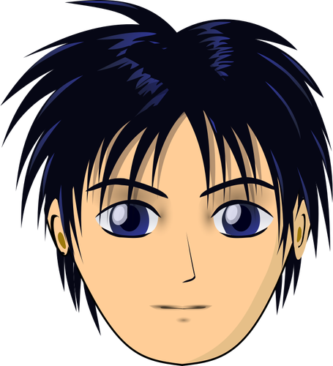
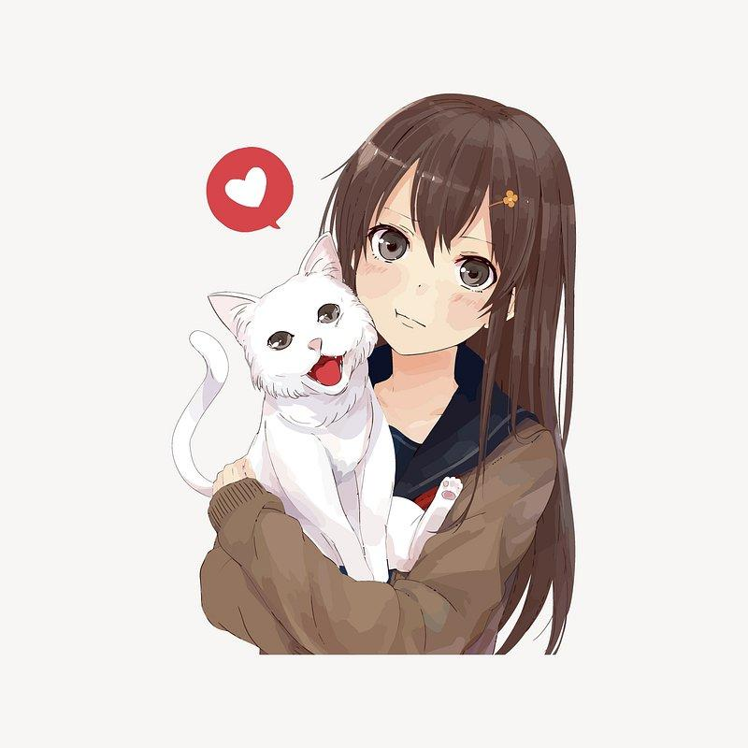
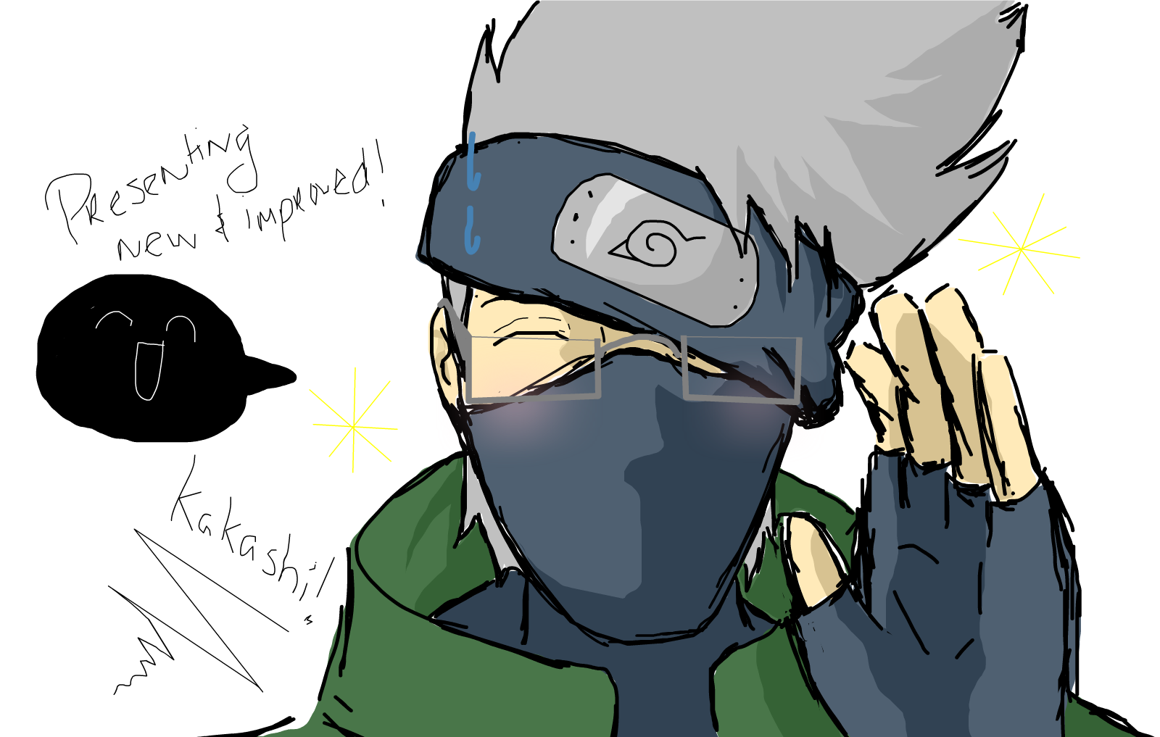
Anime
Anime a style of animation originating in Japan that is characterized by stark colorful graphics depicting vibrant characters in action-filled plots often with fantastic or futuristic themes.
This may be handrawnn or created using digital tools or AI tools.

Slide 14
Disclaimer
Some images may be copyrighted but these images are used for educational purposes and for limited time and used under fair use guidelines.

